Slide 1
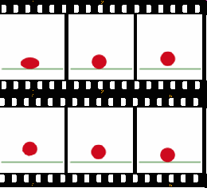
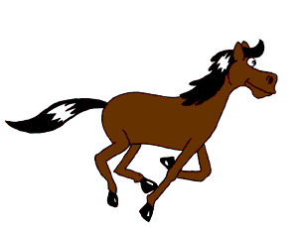
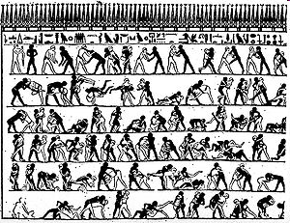

Animation
the rapid display of a sequence of images or model positions in order to create an illusion of movement.

Slide 2
Multimedia
Media and content that uses a combination of different forms such as text, audio,
still images, animation,
video, and interactive content.

Slide 3
Anything that makes human life easier.
Technology
can refer to material objects of use to humanity, such as machines, hardware or utensils, but can also encompass broader themes, including systems, methods of organization, and techniques.

Slide 4
Pattern
Anything that repeats
itself such as shapes,
lines, and colors.

Slide 5

Pattern

Slide 6


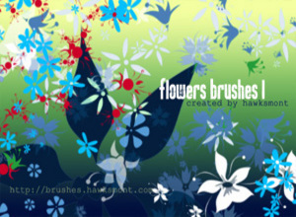


Slide 7
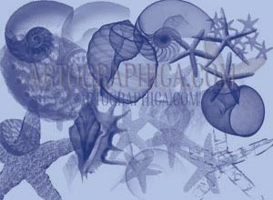
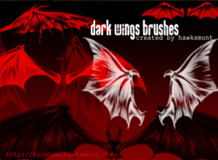
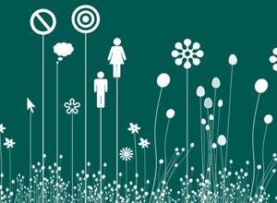
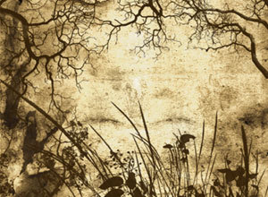

Slide 8
Pattern is
Repetition
Repetition
Repetition
Repetition

Slide 9


Slide 10
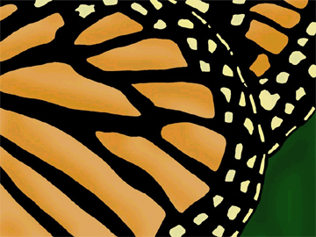

Slide 11
Saturation
the intensity
of a hue

Slide 12
Contrast
the difference of colors
next to eachother

Slide 13
Emphasis
visual enhancement to
something to make it
noticeable and stand out

Slide 14
Unique
one of a kind

Slide 15
Logo
A symbol that
represents something
like a company, team,
place, or person.

Slide 16
3 types of logos:
Illustrative
Graphical
Font-based

Slide 17
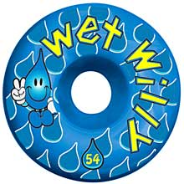
illustrative

Slide 18

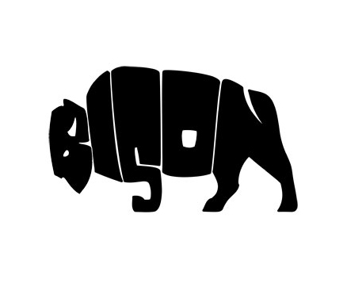
Typography
Font based is also
known as typography.

Slide 19
Typography
the art and technique
of arranging type, type design,
and modifying type

Slide 20

Graphical

Slide 21
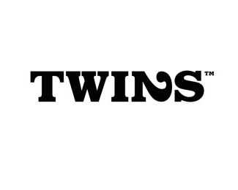
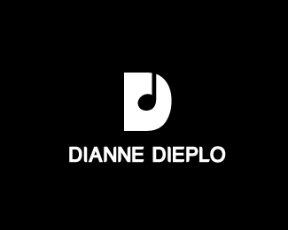

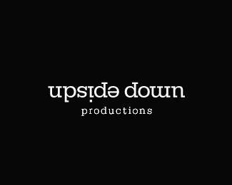

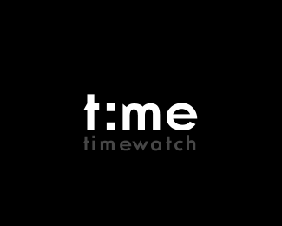
Font Based

Slide 22
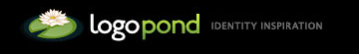
Logos
What Makes a Great Logo Design?
Guide to Creating Professional Quality Logos
Logo Designs Using Gradient Effects
20 Corporate Brand Logo Evolution

Slide 23
Gradient
Gradual
blending
of colors

Slide 24
Resolution
the number of distinct
pixels in each dimension
that can be displayed.

Slide 25
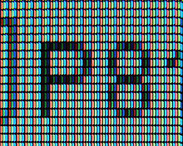
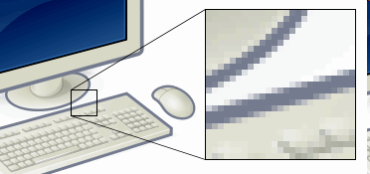
Pixel
The smallest item of information in an image.
Pixels are arranged in a 2-dimensional grid
that represented using dots or squares.

Slide 26
DPI
Dots per inch

Slide 27
PPI
Pixels per inch

Slide 28
Megapixel
Million pixels

Slide 29
What does 72 mean?
Number of dots per
horizontal inch on a
standard computer screen

Slide 30
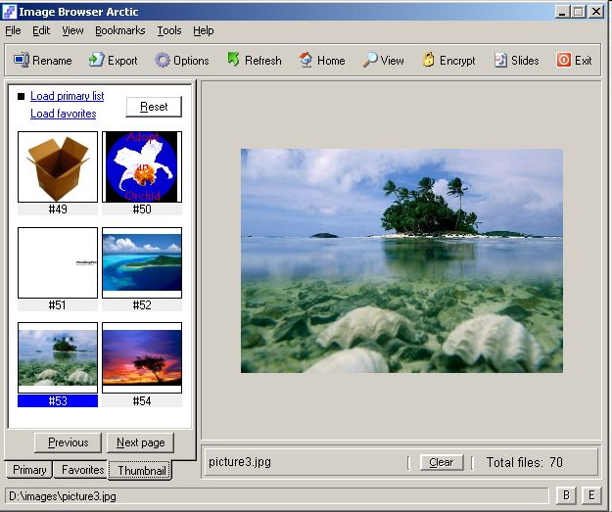
What is a thumbnail?

Slide 31
What is a thumbnail?
a small version
of a larger image

Slide 32
Where did thumbnail term originate?
Leonardo Da Vinci
sketchbooks

Slide 33
What is a critique?
a discussion of work

Slide 34
softcopy
a digital version

Slide 35
hardcopy
a paper version

Slide 36
Bit = smallest amount of
info on a computer (1 or 0)
Byte = 8 Bits = 1 character
10110011 =A
11010110 =B

Slide 37
Bit = 1 number
Byte = 8 numbers = 1 character
Kilobyte = approx. 1,000 bytes
Megabyte = approx. 1 million bytes
Gigabyte = approx. 1 billion bytes

Slide 38
.jpg
is a commonly used method
of compression for
photographic images
16 million colors!

Slide 39

.psd
Photoshop document
containing
graphical layers

Slide 40
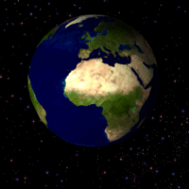
.Gif
Graphic Interchange Format
palette of up to 256 colors
-supports animations
-transparency

Slide 41
.swf
An animated graphical
file created with Adobe
Flash software optimized
for the Internet

Slide 42
Optimize
to make a graphic as visually
perfect, effective, and functional
as possible for the Internet.
(make a file size small & fast)

Slide 43
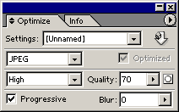
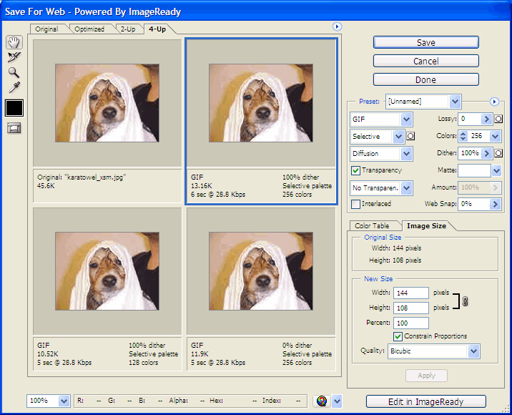
Optimize

Slide 44
.png
Portable Network Graphics (PNG)
PNG was created to improve upon and replace GIF
- 16 million colors
Transparency features
Optimized for Internet

Slide 45
Vector vs. Rastor
Shapes vs. Dots

Slide 46
Vector imaging
is defined by
geometric primitives
as opposed to bitmaps

Slide 47
Rastor imaging
data structure representing a rectangular
grid of pixels of color viewable via a
monitor, paper, or other display medium.

